Slide 1
Misprints Do Hapen
Source: David Wells
Sunday Telegraph 18/9/16

Slide 2


Misprints Do Hapen
Two proof-readers are checking separate copies of the same manuscript.
How many errors would you suspect remain, undetected by either of them?
The first finds $30$ errors, and the second only $24$.
When their completed proofs are compared, it turns out that only $20$ errors have been spotted by both of them.

Slide 3







Misprints Do Hapen
Proof-reader
$$A$$
$$30$$
$$24$$
Proof-reader
$$B$$
$$10$$
$$20$$
$$4$$

Slide 4
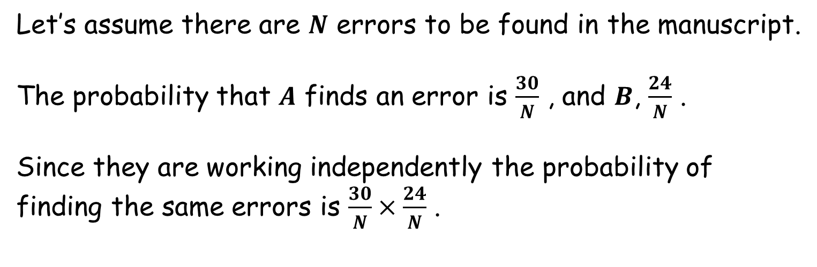



Misprints Do Hapen
$$10$$
$$20$$
$$4$$
Let’s assume there are $N$ errors to be found in the manuscript.
The probability that $A$ finds an error is $\frac{30}{N}$ , and $B$, $\frac{24}{N}$ .
Since they are working independently the probability of finding the same errors is $\frac{30}{N}×\frac{24}{N}$ .

Slide 5
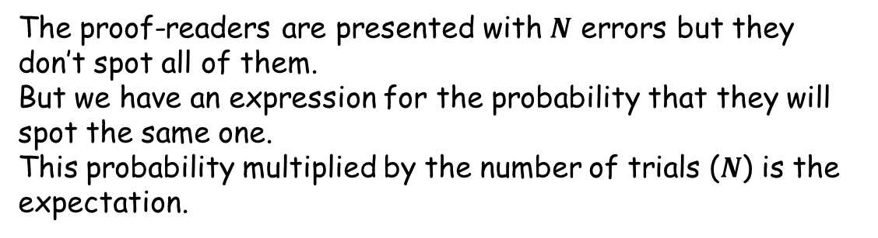

Misprints Do Hapen
$$10$$
$$20$$
$$4$$
The expectation of the number of joint errors found is thus $\frac{30}{N}×\frac{24}{N}×N$, which we are told is $20$.
Alternatively:
$$\frac{30}{N}×\frac{24}{N}=\frac{20}{N}$$
The proof-readers are presented with $N$ errors but they don’t spot all of them.
But we have an expression for the probability that they will spot the same one.
This probability multiplied by the number of trials ($N$) is the expectation.

Slide 6
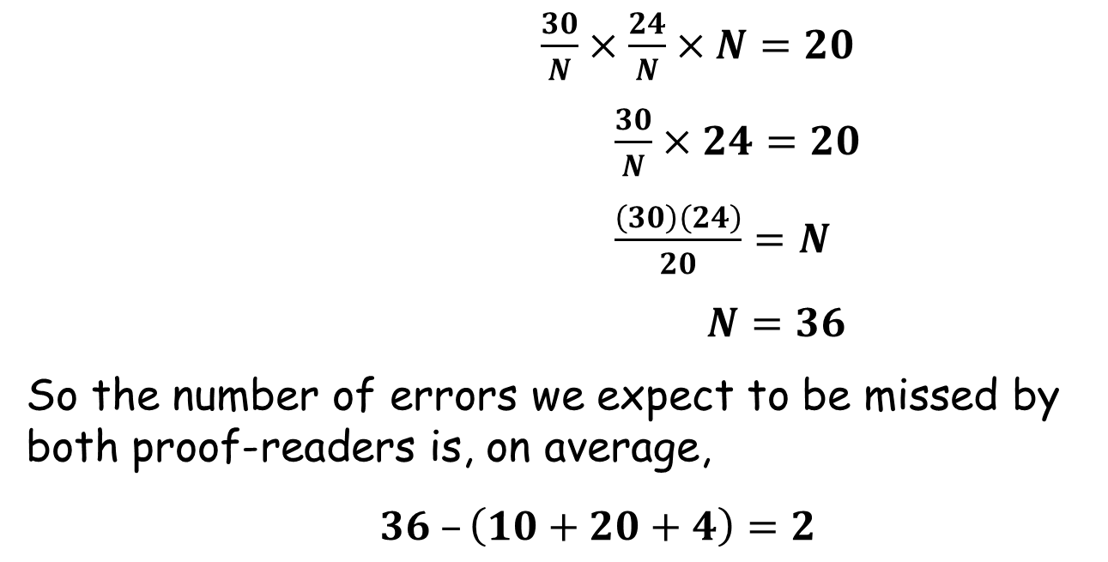
Misprints Do Hapen
$$10$$
$$20$$
$$4$$
$\frac{30}{N}×\frac{24}{N}×N=20$
$\frac{30}{N}×24=20$
$\frac{\left(30\right)\left(24\right)}{20}=N$
$N=36$
So the number of errors we expect to be missed by both proof-readers is, on average,
$36 –\left(10+20+4\right)=2$

Slide 7

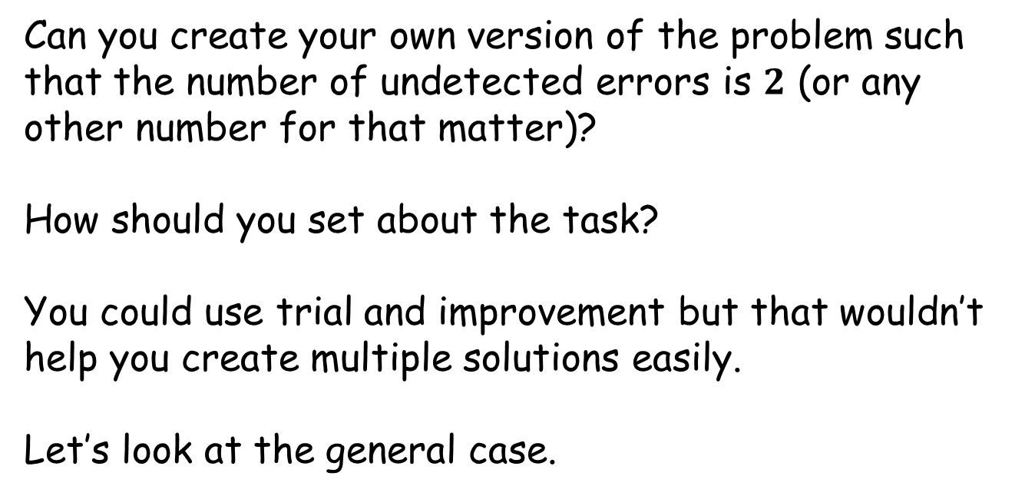



Misprints Do Hapen
Can you create your own version of the problem such that the number of undetected errors is $2$ (or any other number for that matter)?
How should you set about the task?
You could use trial and improvement but that wouldn’t help you create multiple solutions easily.
Let’s look at the general case.
$$a$$
$$c$$
$$b$$
$$n$$

Slide 8

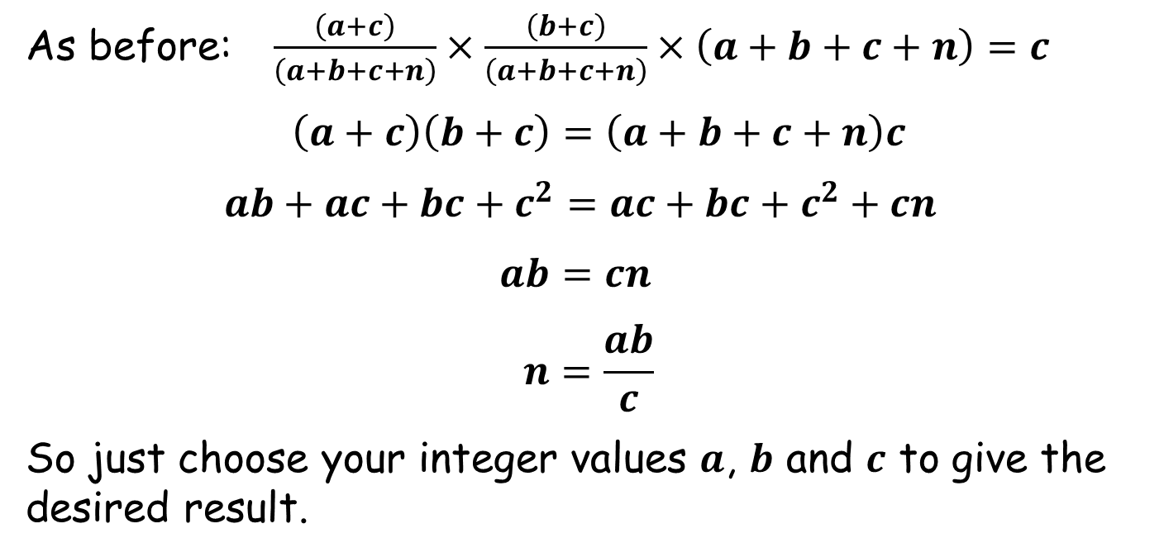



Misprints Do Hapen
$$a$$
$$c$$
$$b$$
$$n$$
As before: $\frac{\left(a+c\right)}{\left(a+b+c+n\right)}×\frac{\left(b+c\right)}{\left(a+b+c+n\right)}×\left(a+b+c+n\right)=c$
$\left(a+c\right)\left(b+c\right)=\left(a+b+c+n\right)c$
$ab+ac+bc+c^{2}=ac+bc+c^{2}+cn$
$ab=cn$
$$n=\frac{ab}{c}$$
So just choose your integer values $a$, $b$ and $c$ to give the desired result.

Slide 10
RESOURCES

Slide 11

SIC_50
Misprints Do Hapen
Two proof-readers are checking separate copies of the same manuscript.
How many errors would you suspect remain, undetected by either of them?
The first finds $35$ errors, and the second only $30$.
When their completed proofs are compared, it turns out that only $25$ errors have been spotted by both of them.

Slide 12

SIC_50
Misprints Do Hapen
Two proof-readers are checking separate copies of the same manuscript.
How many errors would you suspect remain, undetected by either of them?
The first finds $60$ errors, and the second also $60$.
When their completed proofs are compared, it turns out that only $50$ errors have been spotted by both of them.

Slide 13

SIC_50
Misprints Do Hapen
Two proof-readers are checking separate copies of the same manuscript.
How many errors would you suspect remain, undetected by either of them?
The first finds $48$ errors, and the second only $42$.
When their completed proofs are compared, it turns out that only $36$ errors have been spotted by both of them.

Slide 14

SIC_50
Misprints Do Hapen
Two proof-readers are checking separate copies of the same manuscript.
How many errors would you suspect remain, undetected by either of them?
The first finds $32$ errors, and the second only $30$.
When their completed proofs are compared, it turns out that only $24$ errors have been spotted by both of them.

Slide 15

SIC_50
Misprints Do Hapen
Two proof-readers are checking separate copies of the same manuscript.
How many errors would you suspect remain, undetected by either of them?
The first finds $28$ errors, and the second only $25$.
When their completed proofs are compared, it turns out that only $20$ errors have been spotted by both of them.

Slide 16

SIC_50
Misprints Do Hapen
Two proof-readers are checking separate copies of the same manuscript.
How many errors would you suspect remain, undetected by either of them?
The first finds $36$ errors, and the second only $35$.
When their completed proofs are compared, it turns out that only $28$ errors have been spotted by both of them.

Slide 17

SIC_50
Misprints Do Hapen
Two proof-readers are checking separate copies of the same manuscript.
How many errors would you suspect remain, undetected by either of them?
The first finds $28$ errors, and the second only $27$.
When their completed proofs are compared, it turns out that only $21$ errors have been spotted by both of them.

Slide 18

SIC_50
Misprints Do Hapen
Two proof-readers are checking separate copies of the same manuscript.
How many errors would you suspect remain, undetected by either of them?
The first finds $21$ errors, and the second only $20$.
When their completed proofs are compared, it turns out that only $15$ errors have been spotted by both of them.

Slide 19

SIC_50
Misprints Do Hapen
Two proof-readers are checking separate copies of the same manuscript.
How many errors would you suspect remain, undetected by either of them?
The first finds $15$ errors, and the second only $14$.
When their completed proofs are compared, it turns out that only $10$ errors have been spotted by both of them.

Slide 20

SIC_50
Misprints Do Hapen
Two proof-readers are checking separate copies of the same manuscript.
How many errors would you suspect remain, undetected by either of them?
The first finds $10$ errors, and the second only $9$.
When their completed proofs are compared, it turns out that only $6$ errors have been spotted by both of them.

Slide 21

SIC_50
Misprints Do Hapen
Two proof-readers are checking separate copies of the same manuscript.
How many errors would you suspect remain, undetected by either of them?
The first finds $6$ errors, and the second only $5$.
When their completed proofs are compared, it turns out that only $3$ errors have been spotted by both of them.

Slide 22

SIC_50
Misprints Do Hapen
Two proof-readers are checking separate copies of the same manuscript.
How many errors would you suspect remain, undetected by either of them?
The first finds $4$ errors, and the second also $4$.
When their completed proofs are compared, it turns out that only $2$ errors have been spotted by both of them.

Slide 23

SIC_50
Misprints Do Hapen
Two proof-readers are checking separate copies of the same manuscript.
How many errors would you suspect remain, undetected by either of them?
The first finds $12$ errors, and the second also $12$.
When their completed proofs are compared, it turns out that only $8$ errors have been spotted by both of them.

Slide 24

SIC_50
Misprints Do Hapen
Two proof-readers are checking separate copies of the same manuscript.
How many errors would you suspect remain, undetected by either of them?
The first finds $24$ errors, and the second also $24$.
When their completed proofs are compared, it turns out that only $18$ errors have been spotted by both of them.

Slide 25

SIC_50
Misprints Do Hapen
Two proof-readers are checking separate copies of the same manuscript.
How many errors would you suspect remain, undetected by either of them?
The first finds $40$ errors, and the second also $40$.
When their completed proofs are compared, it turns out that only $32$ errors have been spotted by both of them.

Slide 26
SIC_50
Misprints Do Hapen
Two proof-readers are checking separate copies of the same manuscript.
How many errors would you suspect remain, undetected by either of them?
The first finds $60$ errors, and the second also $60$.
When their completed proofs are compared, it turns out that only $50$ errors have been spotted by both of them.

